Slide 1
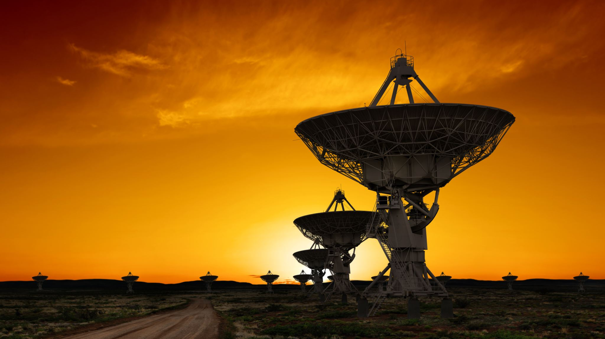
Quasar Satellite Fall Incident
Team 3: Salicia, Leon, Anika, Melissa, Emy, and Makayla

Slide 2


Objectives
Providing details of what happened to the Quasar satellite
Stating the possible causes of the incident occurred
Recommendations on what to do next and how to prevent it
The assailants' motives for this incident.

Slide 3
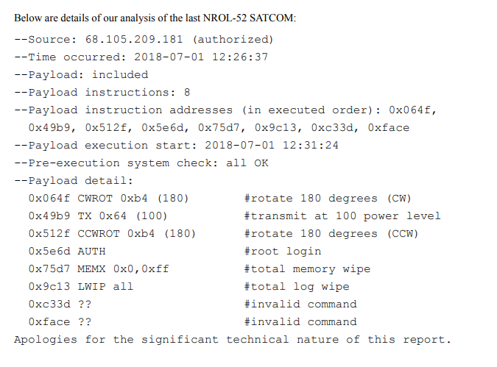
What Happened?..
An 0xb4 (180) degree rotation reoriented NROL-52.
An 0x64 (100) percent transmit operation subsequently occurred. This was followed by another 0xb4 (180) degree reorientation.
An attempt to gain root (admin) access was then made, which included further instructions to erase all memory contents and all log files.
Two final unrecognized commands (with nearly equally unrecognized parameters) were executed.
Several subsystems overheated to levels in which ultimately resulted in the destruction of several satellite subsystems.
On July 1, 2018, less than one year after the launch of Quasar. The satellite left its geostationary orbit and rotated itself 180 degrees away from Earth. Then Quasar released a short communications burst directed toward the center of the solar system. The internal temperatures for the circuits increased resulting to a small explosion leading to multiple events that caused the deorbit of Quasar.

Slide 4

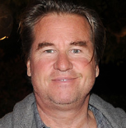

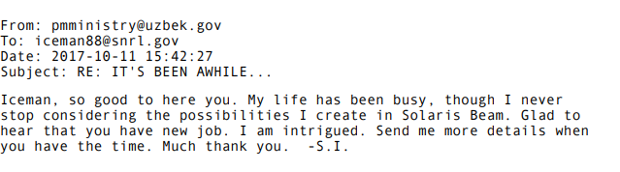
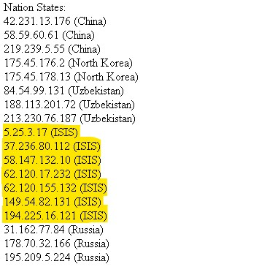
Who did it?
Salim & Edward were shown being accused of the incident.
Salim & Edward cooperated to cause the satellite to malfunction.
ISIS was shown to execute this incident.
Islamic State in Iraq and Syria
Salim Islamovic Mirzov President of Republic of Uzbekistan
Edward “Iceman” Jacobs
Deputy Research Director, Sawtooth National Research Laboratory

Slide 5
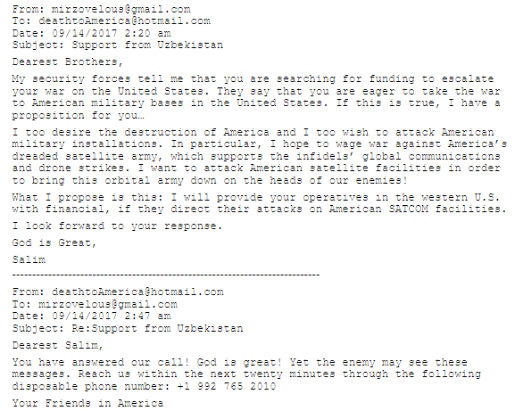
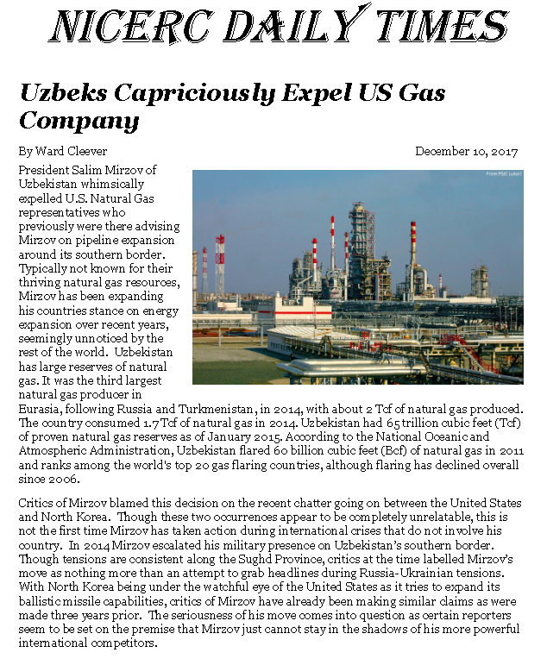
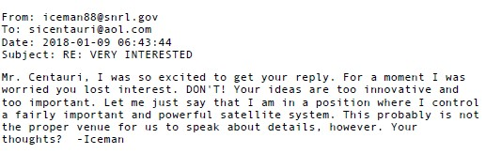
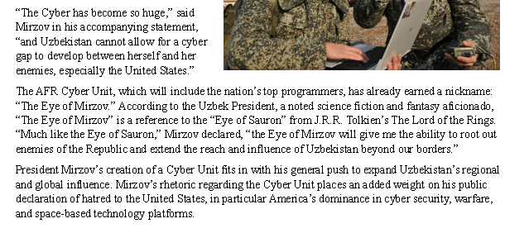
Motives..
ISIS is the main cause. They were involved and funded by Uzbekistan. Both shared the same goal to attack America.
Uzbekistan had an unfriendly relationship with US.
Mirzov Developed the AFR Cyber Unit to increase Uzbekistan’s cyber defense and offensive cyber capability.
Expelled US gas company despite being the third largest natural gas producer.
Iceman had shown keen interest on the Solaris Beam which theorized that it is possible to beam a message to aliens using the sun as an amplifier.

Slide 6
Recommendations..
High-level Encryption
Security Patches
Firewall
Notes:
A firewall is a security system designed to prevent unauthorized access into or out of a computer network.
By encrypting network traffic, you can ensure that it cannot be intercepted by an attacker who might be snooping on the network traffic.
Security patches address vulnerabilities in software, operating systems, drivers, etc., that attackers might use to gain access to your device and your data.
With the use of updated security patches, users could have prevented giving unauthorized access for the system attacks.
It is important to ensure that you download the latest security patches and updates for your operating systems and other software to protect it against cyberattacks. You can also enable automatic updates so that whenever a security patch or update is released, the system automatically installs it.

